Slide 1
ESO press release
(june 4th 2018)
ALMA and VLT Find Too Many Massive Stars
in Starburst Galaxies, Near and Far
http://www.eso.org/public/unitedkingdom/news/eso1817/
Astronomers using ALMA and the VLT have discovered that both starburst galaxies in the early Universe and a star-forming region in a nearby galaxy contain a much higher proportion of massive stars than is found in more peaceful galaxies.
These findings challenge current ideas about how galaxies evolved, changing our understanding of cosmic star-formation history and the build up of chemical elements.

Slide 2
Stellar populations dominated by massive stars in dusty starburst galaxies across cosmic time
(Zhang et al. 2018, Letter in Nature, June 4th 2018)
Zhi-Yu Zhang, D. Romano, R. J. Ivison, P. P. Papadopoulos, F. Matteucci
Probing the distant Universe a team of scientists, led by University of Edinburgh astronomer Zhi-Yu Zhang, used the Atacama Large Millimeter/submillimeter Array (ALMA) to investigate the proportion of massive stars in four distant gas-rich starburst galaxies.
These galaxies are seen when the Universe was much younger than it is now so the infant galaxies are unlikely to have undergone many previous episodes of star formation, which might otherwise have confused the results.

Slide 3
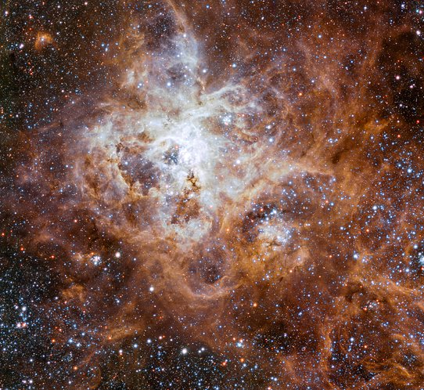
An excess of massive stars in the local 30 Doradus starburst
(Schneider et al. 2018, Science, January)
F.R.N. Schneider, H. Sana, C.J. Evans, J.M. Bestenlehner, N. Castro, L. Fossati, G. Gräfener, N. Langer, O.H. Ramírez-Agudelo, C. Sabín-Sanjulián, S. Simón-Díaz, F. Tramper, P.A. Crowther, A. de Koter, S.E. de Mink, P.L. Dufton, M. Garcia, M. Gieles, V. Hénault-Brunet, A. Herrero, R.G. Izzard, V. Kalari, D.J. Lennon, J. Maíz Apellániz, N. Markova, F. Najarro, Ph. Podsiadlowski, J. Puls, W.D. Taylor, J.Th. van Loon, J.S. Vink, C. Norman
Schneider et al. made spectroscopic observations of individual stars in 30 Doradus, a star-forming region in the nearby Large Magellanic Cloud, using the Fibre Large Array Multi Element Spectrograph (FLAMES) on the Very Large Telescope (VLT).
This study was one of the first to be carried out that has been detailed enough to show that the Universe is able to produce star-forming regions with different mass distributions from that in the Milky Way.

Slide 4
VLT observations
A team led by Fabian Schneider of the University of Oxford, UK, made spectroscopic measurements with ESO’s VLT of 800 stars in the gigantic star-forming region 30 Doradus in the Large Magellanic Cloud in order to investigate the overall distribution of stellar ages and initial masses.
They found around 30% more stars with masses more than 30 times that of the Sun than expected, and about 70% more than expected above 60 solar masses.
Their results challenge the previously predicted 150 solar mass limit for the maximum birth mass of stars and even suggest that stars could have birth masses up to 300 solar masses!

Slide 5
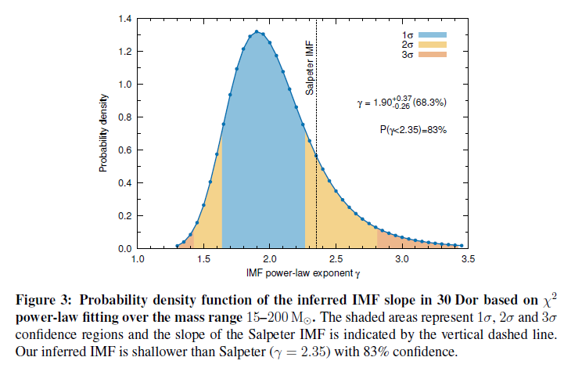

Slide 6
Abstract of paper Schneider et al. 2018
The 30 Doradus star-forming region in the Large Magellanic Cloud is a nearby analogue of large star-formation events in the distant Universe.
We determine the recent formation history and the initial mass function (IMF) of massive stars in 30 Doradus based on spectroscopic observations of 247 stars more massive than 15 solar masses.
The main episode of massive star formation started about 8 Myr ago and the star-formation rate seems to have declined in the last 1 Myr.
The IMF is densely sampled up to 200 solar masses and contains 32 ± 12% more stars above 30 solar masses than predicted by a standard Salpeter IMF.
In the mass range 15 – 200 solar masses, the IMF power-law exponent is 1.90+0.37-0.26 shallower than the Salpeter value of 2.35.

Slide 7
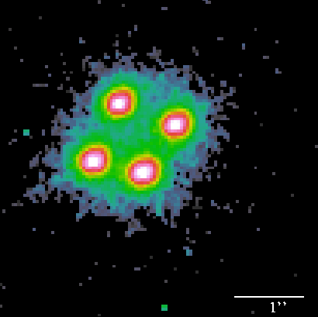
ALMA observations
Zhang and his team developed a new technique to measure the abundances of different types of CO in four very distant, dust-shrouded starburst galaxies.
Their sample comprises the strongest CO emitters in the early Universe,
4 strongly-lensed submillimeter galaxies (SMGs) at z ~ 2–3,
with look-back times ≳ 10 Gyr.
One of them is the famous “Cloverleaf” quasar at z =2.56
They observed the ratio of two types of CO containing different isotopes,
C ¹⁸O and ¹³CO.
¹⁸O is produced more in massive stars, and ¹³C is produced more in low- to intermediate-mass stars. Thanks to the new technique the team was able to peer through the dust in these galaxies and assess for the first time the masses of their stars.
Knowing the proportions of stars of different masses that are formed in galaxies therefore underpins astronomers’ understanding of the formation and evolution of galaxies throughout the history of the Universe.

Slide 8
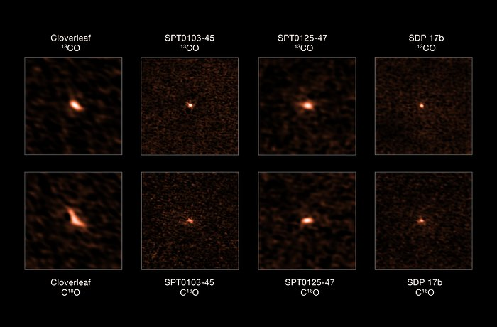
This image shows the four distant starburst galaxies observed by ALMA. The top images depict the ¹³CO emission from each galaxy, while the bottom ones show their C¹⁸O emission. The ratio of these two iso-topologues allowed astronomers to determine that these starburst galaxies have an excess of massive stars

Slide 9
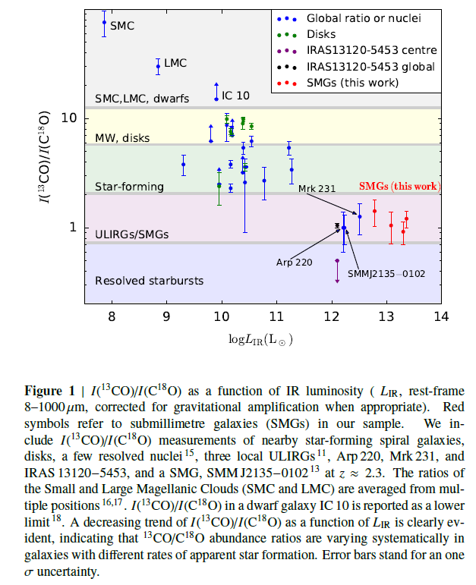

Slide 10
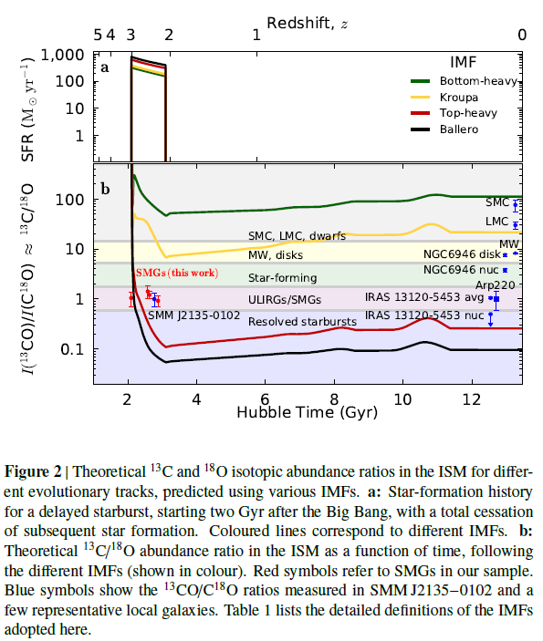
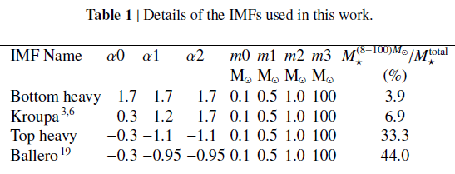
A canonical IMF can never produce a I(¹³CO)/I(C¹⁸O) ratio close to unity, no matter what
type of star-formation history or at what time along a galaxy’s evolutionary track the measurement is made.

Slide 11
Discussion of Zhang et al.
Multiple evidence in the local Universe has shown that the stellar IMF in galaxies with very high SFR densities are likely biased to massive stars, such as ultra-compact dwarf galaxies, ULIRGs, and progenitors of early-type galaxies.
A top-heavy stellar IMF was recently also found in compact stellar associations in the LMC (e.g. Schneider et al. 2018) whose high-density star-formation events may closely replicate what happens over galactic scales in distant starbursts.
Our results for the most intensive star-forming systems in the distant Universe, where classical UV and optical methods cannot be applied, are in line with
these findings.
An IMF biased to massive stars implies that SFRs determined for SMGs must be reduced considerably, since they are based on extrapolations of observables related to massive stars. Moving from the Kroupa IMF to the Ballero IMF, the relative mass fraction of massive stars increases by a factor of 6–7 (see Table 1), meaning that SFRs derived from most classical tracers (e.g. LIR, radio continuum, etc.) must decrease by a similar factor.

Slide 12
Conclusion of Zhang et al. 2018
As a result, dusty starburst galaxies probably lie much closer to the so-called ‘main sequence’ of star-forming galaxies than previously thought.
Classical ideas about the evolutionary tracks of galaxies and our understanding of cosmic star-formation history are challenged.
Fundamental parameters governing galaxy formation and evolution – SFRs, stellar masses, gas-depletion and dust formation timescales, dust extinction laws, and more – must be readdressed, exploiting recent advances in stellar physics.

Slide 13
Abstract of paper Zhang et al. 2018
All measurements of cosmic star formation must assume an initial distribution of stellar masses—the stellar initial mass function—in order to extrapolate from the star-formation rate measured for typically rare, massive stars (of more than eight solar masses) to the total star-formation rate across the full stellar mass spectrum¹. The shape of the stellar initial mass function in various galaxy populations underpins our understanding of the formation and evolution of galaxies across cosmic time². Classical determinations of the stellar initial mass function in local galaxies are traditionally made at ultraviolet, optical and near-infrared wavelengths, which cannot be probed in dust-obscured galaxies^{2,3}, especially distant starbursts, whose apparent star-formation rates are hundreds to thousands of times higher than in the Milky Way, selected at submillimetre (rest-frame far-infrared) wavelengths^{4,5}. The ¹³C/¹⁸O isotope abundance ratio in the cold molecular gas—which can be probed via the rotational transitions of the ¹³CO and C¹⁸O isotopologues—is a very sensitive index of the stellar initial mass function, with its determination immune to the pernicious effects of dust. Here we report observations of ¹³CO and C¹⁸O emission for a sample of four dust-enshrouded starbursts at redshifts of approximately two to three, and find unambiguous evidence for a top-heavy stellar initial mass function in all of them. A low ¹³CO/C¹⁸O ratio for all our targets—alongside a well tested, detailed chemical evolution model benchmarked on the Milky Way⁶—implies that there are considerably more massive stars in starburst events than in ordinary star-forming spiral galaxies. This can bring these extraordinary starbursts closer to the ‘main sequence’ of star-forming galaxies⁷, although such main-sequence galaxies may not be immune to changes in initial stellar mass function, depending on their star-formation densities.

